Slide 1
Time Limited SNAP
Able Bodied Adults Without Dependents
ABAWDs

Slide 2
Presenters
Center for Budget and Policy Priorities
Federation on Human Services Reform
Illinois Department of Human Services
Shriver Center on Poverty Law

Slide 3
Objectives
Quick Overview of the Rule
Who Is Impacted
Why community groups will need to help
Ways you can help & engage in the process

Slide 4
Introductions: TELL US ABOUT YOURSELF
Benefits for SNAP will be time limited for approximately 3,400 DuPage County residents
Have you heard about this requirement?
What do you believe you need to know about this change?
Do you work….
With adults who may be affected?
Do you provide employment services?
Do you provide opportunities for volunteer or community service?

Slide 5
Preparing for SNAP’s 3-Month Time Limit
Center on Budget and Policy Priorities

Slide 6
Able-Bodied Adults Without Dependents (ABAWDs)
Benefits are limited to 3 full months per 3 year period to an individual.
Unless the individual:
is working (paid, unpaid or in-kind) 20 hours a week,
is in a qualifying training slot 20 hours a week,
doing workfare or community service, or
meets one of the limited exemptions
Notes:
FEDERAL LAW – STATE has flexibility on how to implement, but they do not have a choice about implementing in the four counties.
Note the importance of 3 full months.
Some job training activities count, some (like job search) do not.
States can decide what sorts of opportunities to provide – like counting volunteer work as an E&T activity
But most states do not provide an opportunity to everyone
In that case, individual is limited to 3 months in 3 years unless he can find a job or qualifying training program on his own.

Slide 7
Who Is Exempt from the Rule?
Under 18 or 50 years old or older
Working at least 80 hours a month
Residing in household with child under 18
Pregnant
Physically or mentally unfit for work
Caring for an incapacitated person
Receiving or applying for unemployment
Regular participant in drug or alcohol treatment
Eligible student
Notes:
The ABAWD Exemption – consider this the basic: “Is this person an ABAWD?” question . Emphasize the difference between the ABAWD exemption and individual exemptions

Slide 8
Physically or Mentally Unfit for Work
Receive any kind of disability benefits;
Is obviously unfit as determined by the state agency
This includes chronically homeless individuals;
If not obvious, provide a statement from a:
Physician or physician’s assistant,
Psychologist,
Nurse or nurse practitioner,
Social worker,
Representative of a physician’s office, or
any other medical personnel the state determines appropriate
Notes:
When unfitness for work is obvious to the eligibility worker, no statement or verification from medical personnel is needed. FNS Guidance, Nov. 2015.
Best practices:
Worker training to identify individuals
Broad list of medical personnel who can verify unfitness
Clarity around length of unfit status
Built into the recertification process
Question on the application
Part of the interview
A simple, clear form for individuals to fill out.

Slide 9
Who are ABAWDs?
OH Association of Foodbank study of 5,000 ABAWDs found:
1 in 3 reported working in the last year.
1 in 5 are at-risk young adults, under 25, including youth aging out of foster care and exiting juvenile justice systems.
Notes:
OH reimplemented in parts of the state in 2013. In Franklin County, agency contracted with OAFB to provide work experience/workfare opportunities to those subject to the time limit. To do so, OAFB assessed each individual referred, in order to identify barriers to work and what the best placement, if any, was. They continue to do so. Among those referred by the agency were individuals over 50 and individuals clearly mentally or physically unfit for work.

Slide 10
Not Always Able to Work
1 in 3 reported physical or mental disability that limits their ability to perform daily activities.
1 in 4 were under a doctor’s care for conditions like depression, anxiety, PTSD, schizophrenia, diabetes, heart disease, and some reported injuries.

Slide 11
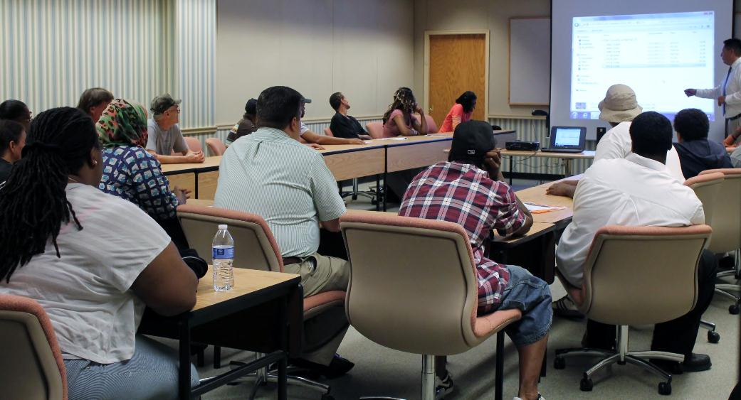
May Lack Basic Skills
30 percent had no high school diploma or GED. Many were marginally and functionally illiterate.

Slide 12
Significant Barriers to Employment
More than 1 in 3 reported having a felony conviction.
Close to 13% were on probation or parole. About 15% reported a DUI violation, limiting their ability to secure employment.

Slide 13
What Else Do We Know?
Childless unemployed adults are very poor. Average income is 22 percent of poverty.
Only 37 percent have an email address.
1 in 4 report having children not in their custody, and 1 in 5 owe child support.
Only 4 in 10 have a valid driver’s license.
Despite 1 in 3 working recently, nearly 80 percent have never received unemployment compensation.

Slide 14
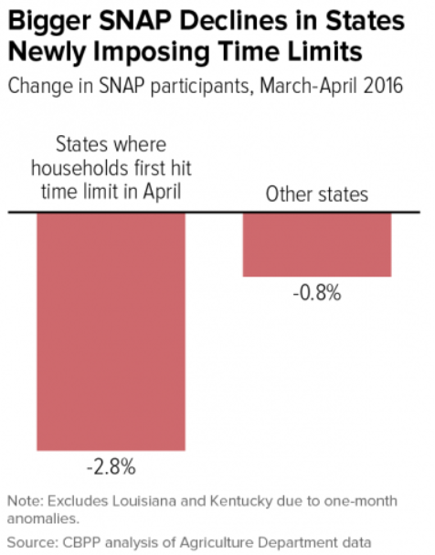
Return of the Time Limit Leads to Drop in Participation

Slide 15
State Challenges to Implementation
Many do not start screening clients early enough
Rule is confusing and new to most
This population is hard to reach
Forms and notices aren’t user friendly
Client circumstances change
Clients struggle to obtain verification

Slide 16
Identifying Exempt ABAWDs: Need More Info
What the state likely knows
What the state needs to know
Age
Last reported income
Household composition
Receiving disability
Residence
Hours worked
Participating in qualifying activity
Unfit for work
Pregnant?
Otherwise exempt?
Any changes since last report
Notes:
States typically will not have the information needed to exempt ABAWDs in the case file
Sorting whether the rule applies requires an individual assessment
Incorrectly applying the rule may result in eligible individuals losing benefits
The work for 2018 is to identify participants who might be an individual subject to the time limit
The information needed to exempt ABAWDs is typically not in the case file
Sorting whether the rule applies requires an individual assessment
Incorrectly applying the rule may result in eligible individuals losing benefits
SNAP agencies need operational capacity prior to the time limit returning

Slide 17
DuPage County
Illinois Policy
Implementation Plan

Slide 18
Current Status
2017: Entire state exempted from work requirement
January 1, 2018: FNS has ruled the exemption from work requirement no longer applies to DuPage County residents

Slide 19
WHO AND WHAT
Age 18-49 non-exempt SNAP recipients
Who live in DuPage County
Can receive SNAP for 3 out of 36 months unless exempt or meet a work requirement
Beginning January 1, 2018 through December 31, 2020

Slide 20
Implementation In DuPage County
IDHS currently reviewing cases to ensure information accurate and clients informed of requirements
Letters sent to persons currently SNAP enrolled informing of the new requirement beginning 2018
Persons newly applying are being told of the requirement and provided a fact sheet
Children 60 days prior to 18th birthday are told of requirement

Slide 21
WHAT IS THE WORK REQUIREMENT?
Participate in training
Basic education
Vocational training includes Perkins training programs
Work experience/intern
Participate in community service possibly 80 hours per month
Must work 80 hours per month
GA Workfare
Volunteer or complete community service
Register to work
Not voluntarily quit job or reduce work hours
Do in-kind work
Must accept suitable offers of employment

Slide 22
EXAMPLES
Paul receives General Assistance from the local township. He does 80 hours a month Workfare to receive this. Paul meets the requirement.
Nancy has not completed high school. She is currently participating in GED classes 20 hours a week. Nancy meets the requirement
Stacy lives at a local motel. In exchange for her rent, Stacy cleans the hotel rooms. The motel owner provides her statement that she is working 80 hours a month. Stacy meets the requirement.

Slide 23
Reporting Work
Work requirement has to be documented at initial application, REDEs and through change rport
If a month is exempt it does not count
Requirement has to be met for any month not exempt
If requirement not met for 3 months the person is ineligible

Slide 24
WHO IS EXEMPT FROM THE WORK REQUIREMENT?
Physically or mentally unfit to work due to a chronic or temporary illness
Living in a SNAP household with children under age 18
Exempt from the work provisions (e.g. in a substance use treatment program, receiving UI, caring for an incapacitated person)

Slide 25
EXPANSION OF STUDENT EXEMPTION
College students can now qualify for SNAP if:
Enrolled in an employment and training program through the Perkins Career and Technical Education Improvement Program OR
Special career or community education program that leads to employment
Participation in this program exempts the student from other ABAWD activities

Slide 26
EXAMPLE
Susan attends College of DuPage and is working on a degree in Hospitality through their Career and Technical Education Program (funded by the Perkins Program). Susan can receive SNAP and meets the ABAWD requirement.

Slide 27
MEDICAL EXEMPTION
How to
A review date will be set by the state
prove
health
exemption
Observation (e.g. cast, pregnant, receives disability benefits)
Statement provided from SW, counselor, DV shelter staff
Medical provider completes Unfit to Work Determination form or provides statement

Slide 28
EXAMPLE: CHRONIC ILLNESS
Chronic Illness: Steve is an Iraqi war veteran who receives at 30% rated VA disability compensation. Steve is exempt. Steve will provide proof of the disability rating that he has. No further documentation is needed
Chronic Illness: Mildred receives mental health treatment through the DuPage County Health Department. She is also in Permanent Supportive Housing. Mildred can provide a note or the Unfit to Work Determination form completed by her counselor at DCHD.

Slide 29
EXAMPLE: TEMPORARY ILLNESS
Temporary Illness: Millie broke her wrist and will be in a cast for the next 3 months. Millie is exempt. Since the worker sees the cast Millie does not need to provide documentation.
Temporary Illness: George participates in substance treatment and currently is unable to work. His substance use counselor provides documentation.

Slide 30
DUPAGE FCRC IMPLEMENTATION
Special team will work on ABAWD cases
Caseworker will review the time clock and update case information showing met or exempt from requirement
Monthly tracking/reporting is done by SNAP client
SNAP eligibility ends when work requirement is not met
If one person in case SNAP case is cancelled
If member of a SNAP household person is deleted from case (if ineligible person has income, the income is prorated for other members)

Slide 31
EXAMPLE
Kevin applies for SNAP and ACA Adult Medicaid in 1/20/18. He is informed of the work requirement.
Kevin does not want to participate in any activities.
He receives a partial SNAP benefit for January, full benefits February, March and April.
His SNAP eligibility ends May 2018.
Heidi receives SNAP and ACA Adult Medicaid. She receives full benefits for January, February and March.
Heidi reports 80 hours volunteer work in February.
She did not do activities in January or March.
Heidi has used 2 months of her requirement.
His medical coverage continues.
Heidi will need to continue to provide proof of participation to continue to receive benefits.

Slide 32
Regaining Eligibility
Eligibility is regained if:
Meet the requirement OR
Now exempt
Benefits reinstated when requirement met for 30 days

Slide 33
Remember Kevin? He lost SNAP eligibility in May. He becomes employed May 10. Kevin can regain SNAP eligibility once he works 80 hours over the next 30 days.
If his case was canceled, Kevin needs to file a new application.
Remember Kevin has to meet the work requirement before his application is approved or he is added (this includes expedited SNAP)
If he was a household member, he can be added back to the case.

Slide 34
YOUR HELP IS NEEDED
Please help us ensure no one loses SNAP benefits
Tell people about this change
Help identify persons who are exempt and provide support to verify/prove exemption
Link people to employment, community service opportunities
Encourage clients to set up a MMC account so they have access to notices
Make sure people keep their address current

Slide 35
SNAP’s Three Month Time Limit: The Role for Community Groups

Slide 36
Informing and Educating Clients
Notes:
Fliers for clients – be sure that they are correct and consider just doing one template version for the state that can be customized locally. Most groups got them wrong on the first run out. So, be sure that state partners and others with expertise review them.

Slide 37
Informing and Educating Community Partners
Fliers from NY and PA anti-hunger groups
Web sites and webinars
Notes:
Fliers to send out,
Newsletters
Newsletter they can use
PA and MA were constantly stealing from eachother.

Slide 38
Outreach to Medical Providers

Slide 39
Helping Clients Obtain Exemptions
Coordinate with the County-State on their plans
Train application assistors
Explaining the rules to health professionals
Screening clients at your programs
Before and after the cut-off
Use the state’s forms or develop your own
Help clients gather needed verification

Slide 40
Working to Tell the Story
Notes:
Time limit – not used in these headlines!
Talking points for locals is critical. Food bankers are notorious for saying that can/will help anyone – because they will! But, want to focus on the rule being unfair, etc.

Slide 41
BREAKOUT DISCUSSIONS
How can you help identify exempt clients?
What can you do to assist with completion of exemption requests?
How else does this need to be communicated to ensure everyone who needs to know, knows?
What else would you need from the state staff to ensure this works?
Break into small groups and discuss the following:

